Slide 1
Cloud Native Buildpacks
Simplify and secure container lifecycle through automation
October 2021

Slide 2
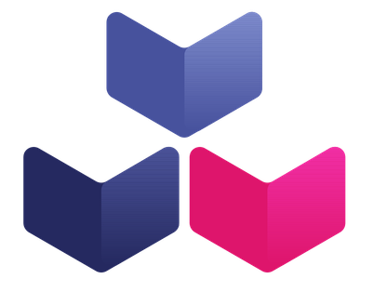


Cloud Native Buildpacks,
a higher-level abstraction to build containers.
Notes:
The Cloud Native Buildpacks project was initiated by Pivotal and Heroku in January 2018 and joined the Cloud Native Computing Foundation in October 2018. The project aims to unify the buildpack ecosystems with a platform-to-buildpack contract that is well-defined and that incorporates learnings from maintaining production-grade buildpacks for years at both Pivotal and Heroku.

Slide 3
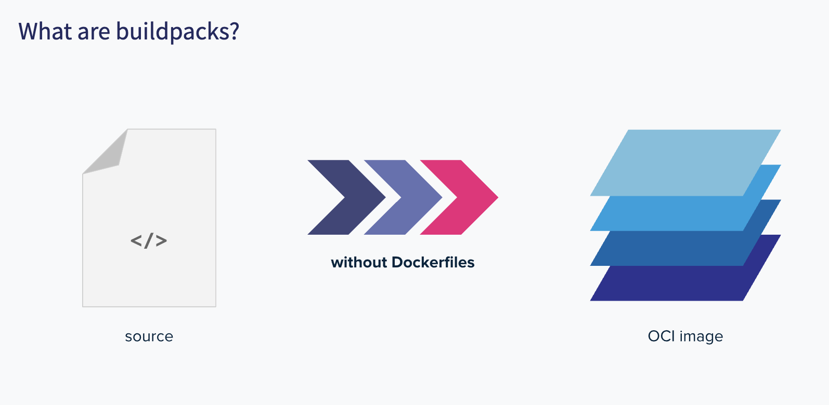
Notes:
Buildpacks provide framework and runtime support for applications. Buildpacks examine your apps to determine all the dependencies it needs and configure them appropriately to run on any cloud.

Slide 4

Cloud Native Buildpacks
Specification to translate application code to OCI compliant container image
Source Code
OCI Container
Developer
Cloud Native Buildpacks
Notes:
Buildpacks allow you to convert your source code into a secure, efficient, production ready container image.
So, what is CNBP? is purely a specification project to turn applications into OCI compliant containers. It consists of buildpacks which is an object that scans the source code, by running a process against it called lifecycle and at the end of the process exports an OCI image that can run on any k8s platform. Goal is to make it as easy as possible to go from source code to OCI compliant containers.
Drives Consistency
Creates a mechanism to separate developer concerns from operational maintenance and security
Builds on years of experience running millions of containerized workloads a scale

Slide 5
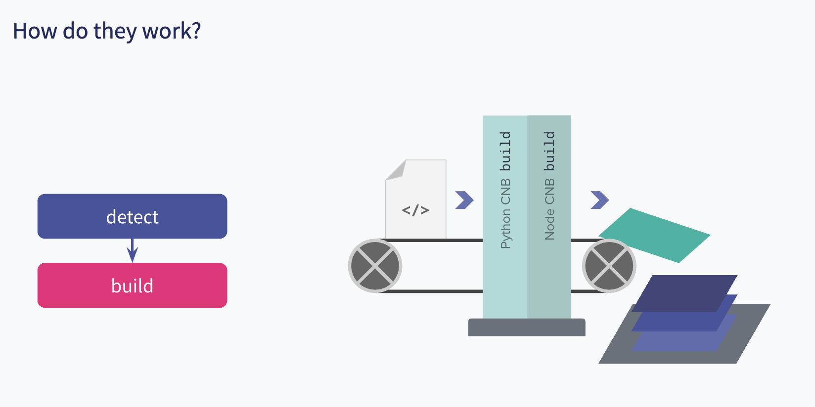
Notes:
Each buildpack comprises of two phases -
Detect phase
The detect phase runs against your source code to determine if the buildpack is applicable or not. Once a buildpack is detected to be applicable, it proceeds to the build stage. If the project fails detection the build stage for a specific buildpack is skipped.
A Python buildpack may look for a requirements.txt or a setup.py file pass
A Node buildpack may look for a package-lock.json file to pass
Build phase
The build phase runs against your source code to -
Set up the build-time and run-time environment
Download dependencies and compile your source code (if needed)
Set appropriate entry point and startup scripts
For example:
A Python buildpack may run pip install -r requirements.txt if it detected a requirements.txt file
A Node buildpack may run npm install if it detected a package-lock.json file

Slide 6
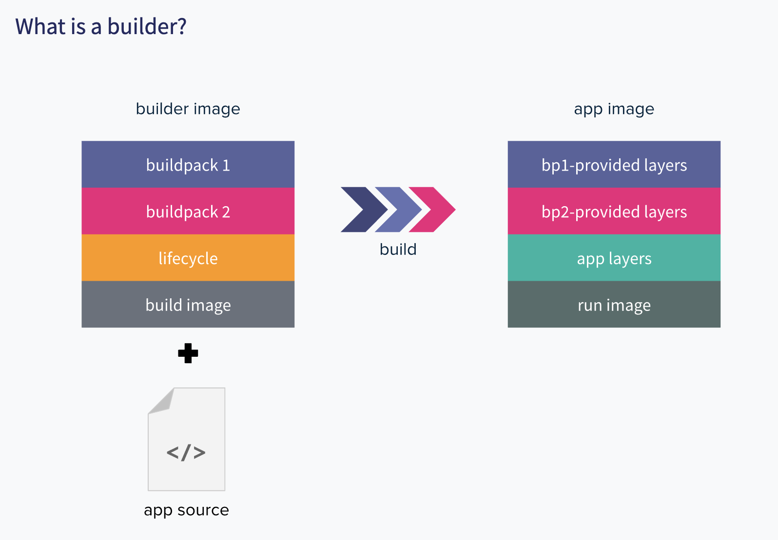
Notes:
Builders are an ordered combination of buildpacks with a base build image, a lifecycle, and reference to a run image. They take in your app source code and build the output app image. The build image provides the base environment for the builder (for eg. an Ubuntu Bionic OS image with build tooling) and a run image provides the base environment for the app image during runtime. A combination of a build image and a run image is called a stack.
Under the hood a builder uses the lifecycle to run the detect phase for all the buildpacks it contains in order and then proceeds to run the build phase of all the buildpacks that passed detection.
This allows us to have a single builder that can detect and build various kinds of applications automatically

Slide 7
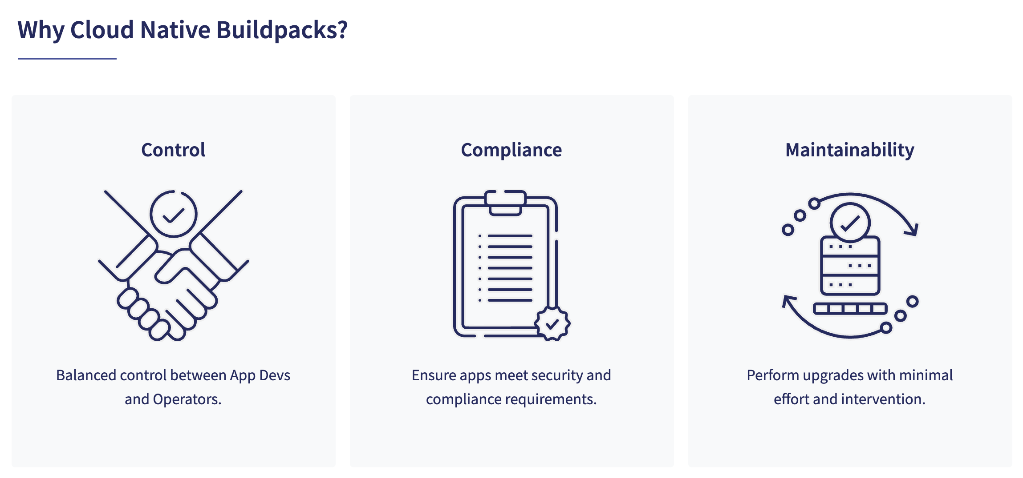
Notes:
Containers are everywhere in your organization. Enterprises are moving rapidly to adopt cloud native patterns. And containers are the foundational building block for these cloud native applications. At their best, containers can improve development velocity, operational efficiency, and reduce risk.

Slide 8



Dockerfile: Most common way of creating containers
Popular and easy to get started
DOCKERFILE TO CREATE JVM
Good starting point
Descriptive file specification
Flexibility is their power
Notes:
Dockerfile - Dockerfile is every developer's friend. Most of you on this call have seen dockerfiles and have used them at some point in time. And how it plays out is the team is just getting started with K8s and containers; the projects are small and simple; and it's this very familiarity with dockerfiles that gets things started.
Plus they are descriptive, free form files - you specify the operating system, application file system, and the command that’s going to run the application. It's a nice single point of assembly for how you’d like to build the container.
Easy to use on Day1 but what about Day 2 operations? Interestingly enuff the flexibility of dockerfiles that brings in the power …. is problematic.

Slide 9

Containers built using dockerfile are hard to productionize and scale
When dev teams build images differently, they introduce vulnerabilities and complexity
Problem
My app 1
Broken Build
Image updates Hard to debug, fix and maintain non-standard images across the fleet
Security posture Challenging to keep container images free of vulnerabilities
Full stack container audits Hard to uniformly track container dependencies
IT governance Hard to reinforce software compliance
JDK I found
Trusty OS
Unverified Update
My app 2
Trusted JDK
Hard to track and patch CVE
ubuntu
My app 3
Trusted JDK
Out of Compliance
CentOS
Notes:
First, it is the wrong layer of abstraction for application developers, OS layers don't and should not matter if I am an application developer. Second, Inconsistencies creep up as different teams adopt different variations of dockerfile-based solutions across the fleet of containers. Every team has their own recipe for baking these containers, And their recipes start to drift over time. So the containers, are not uniform. Suddenly, you might find yourself dealing with 32 variants of jdk running in production, different versions of operating systems, libraries, dependencies. They might not even be the most trusted artifacts hardened for production usage. And that’s a huge problem. Bcoz now you have a gapping hole in your supply chain. We’ve all just heard about it - It's a nightmare of what’s happened with SolarWinds.
Issues that arise from these Manual workflows to build and maintain container images can be categorized into 4 problem areas:
First, Image updates: Image updates are going to be hard because of the image configuration drifts. Lot of things become bespoke, and snowflakes arise. which affects the ability to fix problems that arise in a timely manner. The time to resolve these broken builds is now directly proportional to the knowledge of the person available to fix these issues. You are now relying on the tribal knowledge that a particular container dockerfile has.
Second, bcoz Security is managed through manual checkpoints and audits. it makes it really hard to track and patch CVEs on a fleet wide basis. not having an end to end, iron clad pipeline w/ custody of where the binaries are coming from; vulnerabilities definitely will creep in.
W/o a federated solution, full stack container audits, reinforcing compliance is a nightmare. Let's say you want to implement a monitoring tool across your entire fleet, but your fleet is built differently. There is no uniformity so how do you track the images? Or If you are going for Fedramp compliance, how do you ensure that every container that is running in your production fleet, actually is in compliance?
So, even though dockerfiles are easy to use upfront, it is not the right horse to bet on for enterprise scale. There is so much effort for a good dockerfile and Trying to keep dockerfiles up-to-date inside of enterprise is tricky and challenging.

Slide 10


Must-Have Attributes of Ideal Container Build Solution
Easy to Use,
Repeatable
Reliable,
Scalable
Secure,
Portable
The solution must be easy to adopt on Day 1 and Day 2
Teams with different tech preferences should be able to standardize on the chosen solution
The solution has to work in a complex enterprise environment
Ideally, the solution would be based on proven technology
Does the solution reduce risk? How?
Does it lock me into a specific vendor?
How does it work with my existing environments?
Notes:
Once the enterprises realize they have a problem, what do they look for in the solution? What are the desired benefits? What outcomes do they want? These are the top 3 we’ve heard so far.

Slide 11
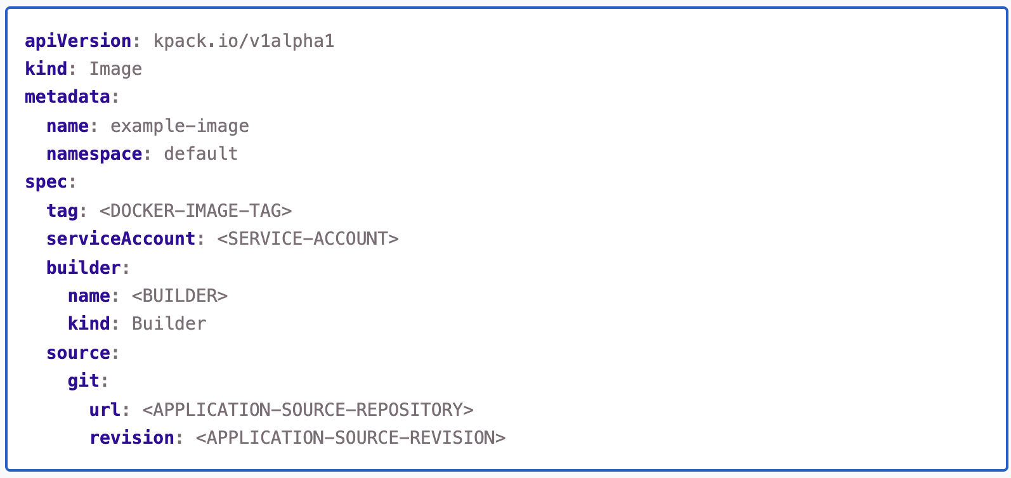
kpack
Kubernetes-native platform for buildpacks
Notes:
kpack is a Kubernetes native platform maintained by VMware under the VMware Tanzu project that utilizes unprivileged Kubernetes primitives to provide builds of OCI images as a platform implementation of Cloud Native Buildpacks (CNB).

Slide 12
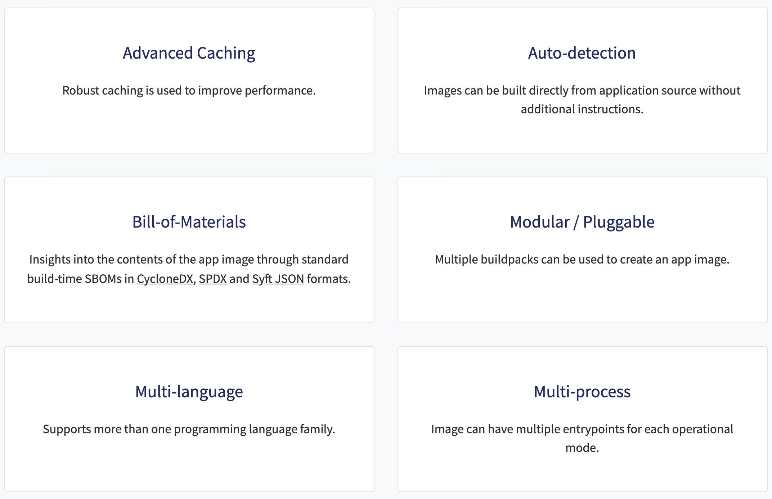
Why Buildpacks?

Slide 13
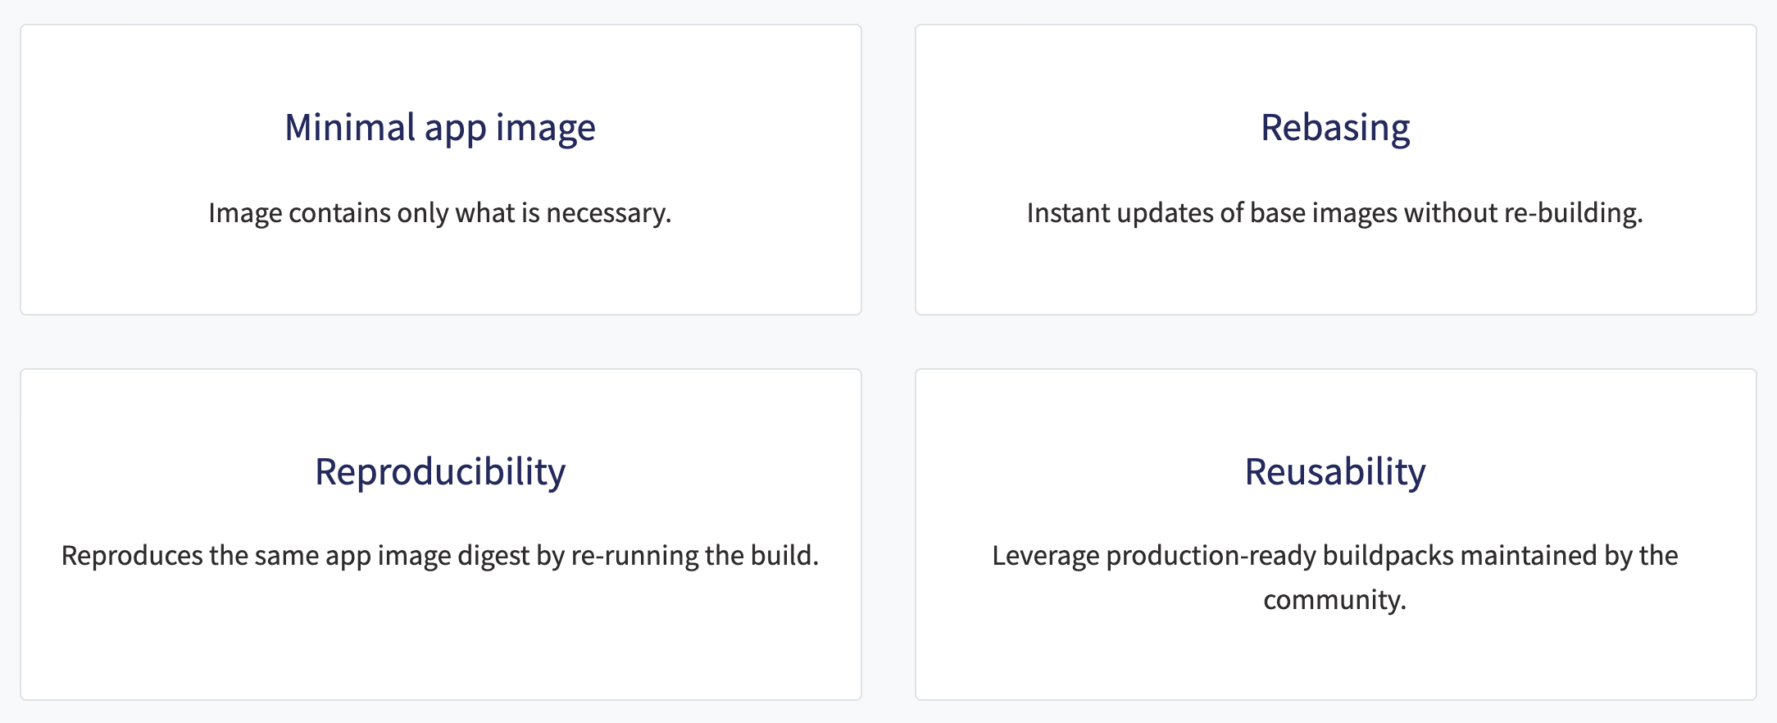
Why Buildpacks?

Slide 14
Demo Time!

Slide 15
Thank You. Questions?

